Slide 1
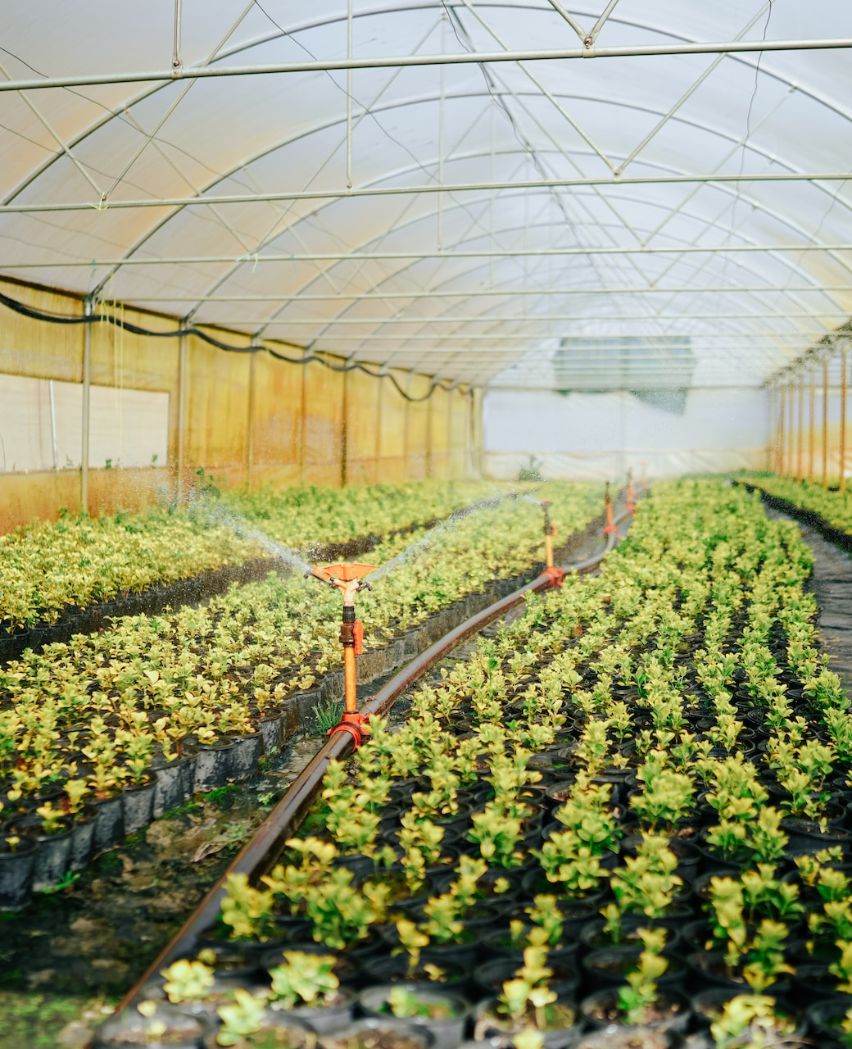
Agricultural Crop Production Analysis
CREATED BY: Saransh Agarwal DATE: 14 - October - 2024

Slide 2

Objective of Study
PURPOSE OF THE RESEARCH
This study aims to derive insights into crop performance, focusing on historical trends and significant factors impacting agricultural productivity. This project analyzes agricultural crop production data from various states and districts in India over multiple years. The objective is to derive valuable insights into the performance of different crops, their production trends, and the efficiency of land use (yield) using SQL and visualize the findings using Power BI/Tableau. The dataset includes detailed information such as crop type, area cultivated, production quantity, season, and year, making it ideal for advanced data analysis and reporting.

Slide 3
Data Overview
State_Name: Name of the state where the crop was grown.
District_Name: District within the state.
Crop_Year: Year of crop production.
Season: Season in which the crop was grown (e.g., Kharif, Whole Year).
Crop: Type of crop produced.
Area: The area (presumably in hectares) used for cultivation.
Production: The crop production output (presumably in metric tons).

Slide 4
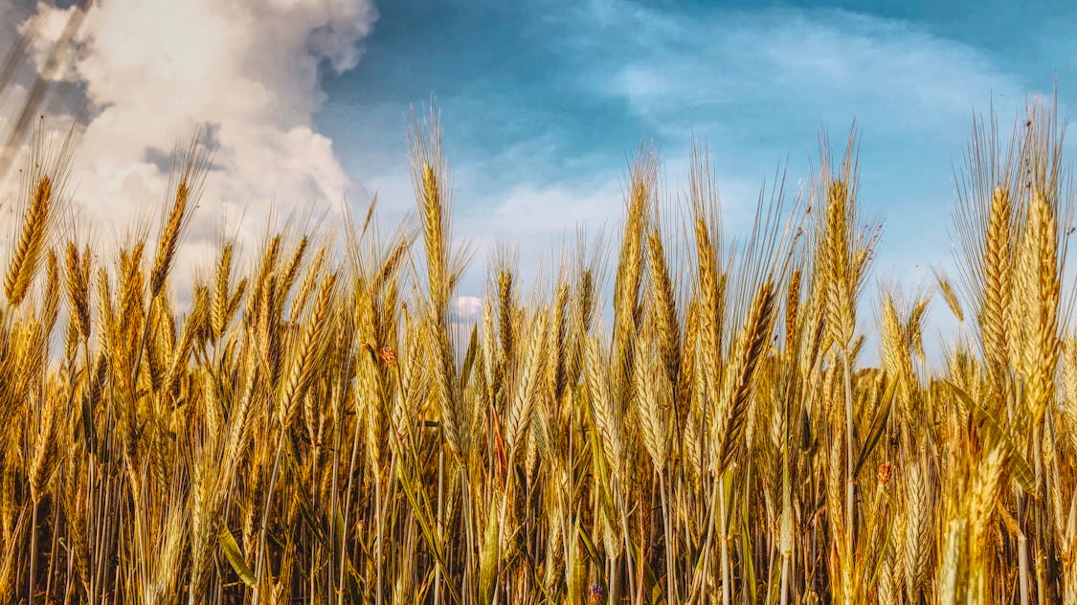
Crops Analysed
KEY CROPS STUDIED
The analysis covers major crops such as coconut, rice, and corn that dominate production in various regions. These crops are typically studied in depth to understand their growth patterns, yield potential, disease resistance, and adaptability to changing climates.
SIGNIFICANCE OF CROPS
These crops play a critical role in food security and economic stability, affecting millions of livelihoods globally. Their importance spans across multiple dimensions, from providing food and nutrition to fueling industries and global trade.

Slide 5

SQL Queries To Find Key Insights

Slide 6
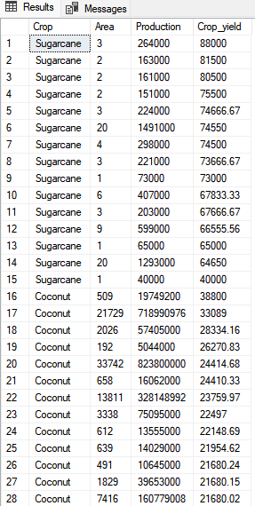
Calculate crop yield (production per unit area) to assess which crops are the most efficient in production SELECT Crop, Area, Production, ROUND((Production/Area), 2) as Crop_yield FROM crop_production ORDER BY Crop_yield DESC;
Sample Output
Description
This Query defines the crop yield for each crop in terms of production. In this first we are selecting the columns i.e., Crop, Area, Production, Round((Production/Area), 2) as Crop_yield from Crop_production table (that is defined while importing the data) then ordered the whole query according to the Crop_yield in descending order.
-- Round((Production/Area), 2) as Crop_yield --
Round – This function rounds off a specified number to a decimal place.
Production/Area – This finds the production per area.
Crop_yield – Aliasing given to the column

Slide 7
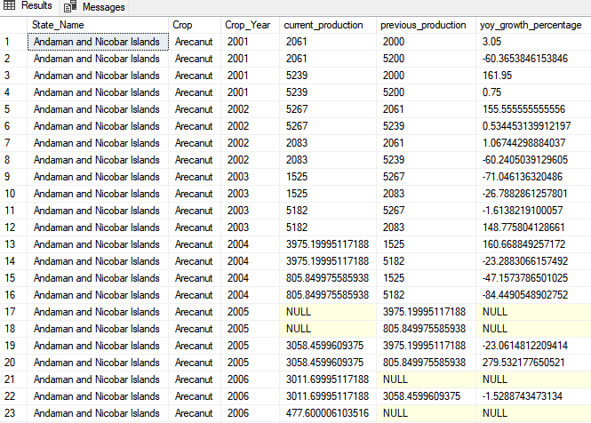
Calculates the year-over-year percentage growth in crop production for each state and crop SELECT current_year.State_Name, current_year.Crop, current_year.Crop_Year, current_year.production AS current_production, previous.production AS previous_production, case when previous.Production > 0 then ((current_year.production - previous.production) / previous.production) * 100 else null end AS yoy_growth_percentage FROM crop_production current_year JOIN crop_production previous ON current_year.State_Name = previous.State_Name AND current_year.Crop = previous.Crop AND current_year.Crop_Year = previous.Crop_Year + 1 ORDER BY current_year.State_Name, current_year.Crop, current_year.Crop_Year;
Description
This Query calculates YOY percentage growth in crop Production. In this query we joining the table with itself(Self Join) to compare the previous year’s production with the current year’s production. First we are selecting State_Name, Crop, Crop_Year, Production(Current), Production(Previous) from the crop_production table then join it with itself with some case conditions.
Case – Condition when previous Production is more than 0
((current_year.production - previous.production)/previous.production)*100 – change percentage
Join – Joins the table on one record ahead because of comparison
Order by – Orders the output according to the State_Name, Crop, Crop_year
Sample Output

Slide 8
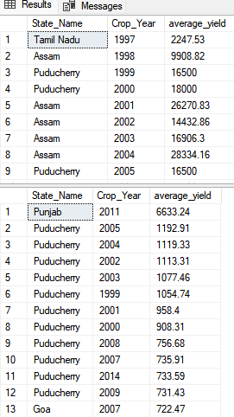
Calculates each state's average yield (production per area) and identifies the top N states with the highest average yield over multiple years. WITH CTE AS( SELECT State Name, Crop Year, Production, Area, ROUND(AVG(Production/Area), 2) as average yield, DENSE_RANK() OVER(PARTITION BY Crop_Year ORDER BY AVG(Production/Area) DESC) as rank FROM crop_production GROUP BY State Name, Crop Year, Production, Area ) SELECT State Name, Crop Year, average yield FROM CTE WHERE rank = 1 SELECT State Name, Crop Year, ROUND(AVG(Production/Area), 2) as average yield FROM crop_production GROUP BY State Name, Crop Year ORDER BY average yield DESC
Description
This query is returning each state’s average yield and top states with highest average yield over multiple years.
First we are creating a CTE(Common Table Expression) in which we are selecting columns required with additional average yield and a RANK column then using group by on columns
CTE - It is used to reduce complexity between queries.
Average yield – It is avg of production per area
Rank – It is used to give numbering to each row according to the given parameters i.e., Partition by (It divides the rows of the given column) and order by (It orders the given column)
Sample Output

Slide 9
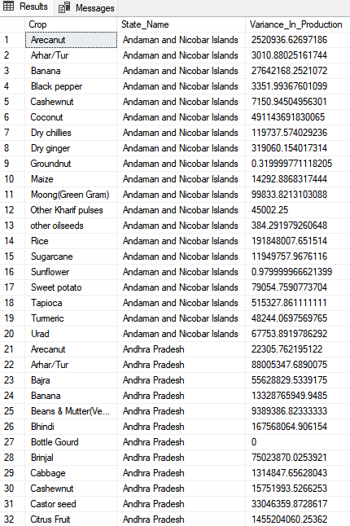
Calculates the variance in production across different crops and states SELECT Crop, State_Name, VAR(Production) AS Variance_In_Production FROM crop_production GROUP BY Crop, State_Name ORDER BY State_Name, Crop
Sample Output
Description
In this query, We find the Variance_In_Production in production of each crop in each state by using SQL built-in function i.e., VAR. then Grouped by required columns and then order them accordingly.
Variance_In_Production – It is a statistical word meaning square of average distance between each quantity and mean. It also states that how the data is spread out around the mean. In our case, The variance provides insight into how much the production levels of different crops or states differ from the average production level.

Slide 10
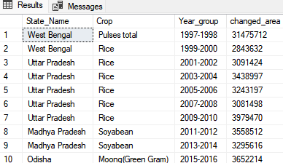
with years_grouping as( select State_Name, Crop_Year, Crop, CONCAT(FLOOR((crop_year - 1997) / 2) * 2 + 1997, '-', FLOOR((crop_year - 1997) / 2) * 2 + 1998) as Year_group, sum(Area) as total_area from crop_production group by Crop_Year, State_Name, Crop ), previous_area_table as( select State_Name, Year_group, Crop, total_area as current_area, LAG(total_area, 1) over(partition by year_group order by total_area desc) as previous_area from years_grouping ), Total_area_changed as( Select State_Name, Crop, Year_group, current_area, previous_area, (previous_area - current_area) as changed_area from previous_area_table ), ranking as( select State_Name, Year_group, Crop, changed_area, DENSE_RANK() over(partition by Year_group order by changed_area desc) as rnk from Total_area_changed ) select State_Name, Crop, Year_group, changed_area from ranking where rnk = 1;
Identifies states that have the largest increase in cultivated area for a specific crop between two years
Description
In this query, we are trying to find the state that have largest increase in area for crops between two years of group. In first CTE(years_grouping) we are making groups of two corresponding years e.g. 1997-1998 or 2001-2002 with year_group column. In second CTE(previous_area_table) we are using LAG built in function to show previous row of every row. In third CTE(Total_area_changed) we are finding total area changed by subtracting the previous year’s area from current year’s area. In forth CTE(Ranking) we are giving ranks to the highest area changed to the lowest. Then we selecting the required columns of the rank = 1
Year_group –
The CONCAT function creates a group label for every 2-year period. We calculate the range by subtracting 1997 from the year, dividing it by 2 (which groups every two consecutive years together), then using FLOOR to group them properly. This produces ranges like ‘1997-1998', ‘1999-2000', etc.
Sample Output

Slide 11
Key Findings
YEARLY TRENDS
REGIONAL INSIGHTS
PRODUCTION INSIGHTS(Crop wise)
Highest production was recorded in 2011 with 14.31 billion tones.
Production dropped significantly in 2012 and 2014.
Other years with high production include 2013 (12.90 billion tones) and 1999-2000 (approximately 6-7 billion tones).
Kerala(97.88 billion tonnes), Andhra Pradesh(17.32 billion tonnes), and Tamil Nadu(12.08 billion tonnes) are far ahead of other states, showing a strong contribution to overall production, likely driven by specific high-production crops.
Other notable states include Uttar Pradesh (3.23 billion tones), Assam (2.11 billion tones), and West Bengal (1.40 billion tones).
Whole Year crops have the highest total production, with 134.42 billion tones.
Kharif season production is significant at 4.03 billion tones, followed by Rabi season with 2.05 billion tones.
Other seasons (Autumn, Summer, Winter) contribute smaller amounts in comparison.

Slide 12
Thank
you

